Slide 1

ARK Fund Applet
Brandon Tran Jan2021

Slide 2
Disclaimer
I am not a financial adviser
This applet project is purely for my own education in both programming & finance
If you wish to use this project for your own purposes, please use responsibly
I am not a lawyer
I assume that because the information is publicly available to download, it is therefore reasonable to play with the data
However most of the time … assuming is never right! Therefore, I am not a lawyer

Slide 3
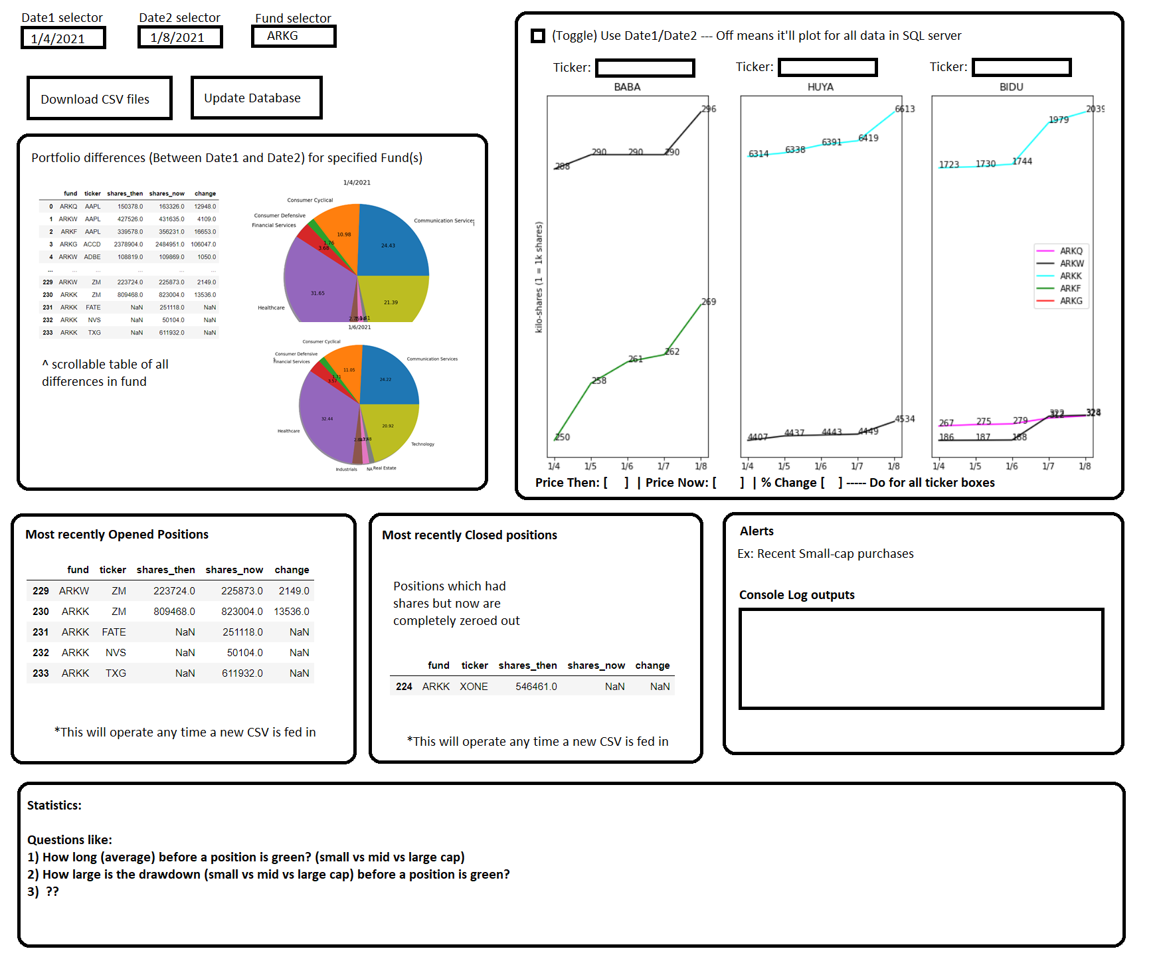
Applet Design (Brainstorm)

Slide 4
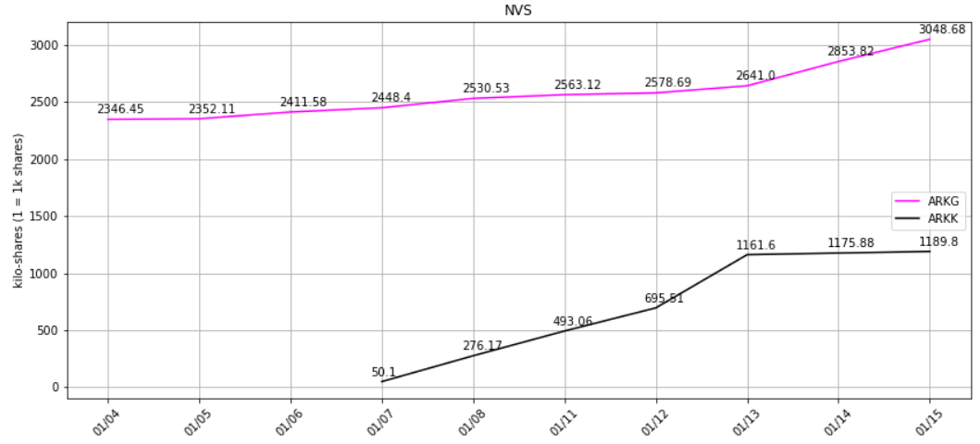
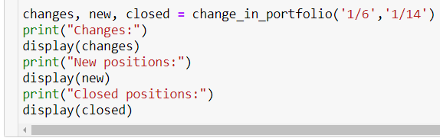
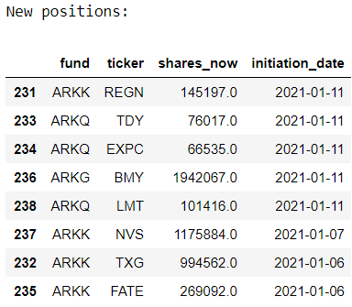
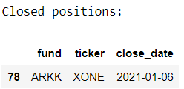
Change Logs – 1/17
Change_in_portfolio() issues:
1) date1/date2 required
2) new df wouldn’t properly populate unless the new position occurred on the exact transition from X to Y date
3) same issue as #2 with `closed` df
Solution:
1) Now defaults to previous day + current session if not provided
2) Created `unique_dates` & `loc_initial_date` variables so that “1/11” would expand the search to “1/10”… because you can’t know a position is new unless you know it wasn’t there yesterday.
3) Along with #2’s soln, changed `a` and `b` to generate from `unique_dates[loc_initial_date]` instead of `date1` to capture that initial date
4) Did some small house cleaning by dropping unnecessary columns (like cap,market_cap) in preprocessing
ticker_lookup() Issues:
1) “FATE” (ARKK had started purchasing it on 1/7) would screw up the x-axis
2) Legend was incorrectly stating which fund was which line (Ex: ARKG doesn’t buy Paypal)
Solution:
1) Created `date_val` and `date_label` variables to appropriately handle a changing x-axis
2) Created `fund_labels` to appropriately point the data to the fund
This command now correctly notes any new/closed positions between the dates provided

Slide 5
Change Logs – 1/17
change_in_portfolio update
Functionality for an “alert” system prompted the computation of “Percent Change” column
Alert system update
Need to find a way to trigger an alert message whenever X occurs
Currently taking X as a 10% increase or decrease in position sizing

